Slide 2
Today’s Roadmap
Understanding the Data - Energy Metering/Monitoring Basics
K-12 Applications - Energy Savings & Demand Reduction Opportunities
Making it Happen - Implementing a Best Practices Approach
Looking to the Future – New and Upcoming Diagnostic Tools
Q&A

Slide 3
Utility Cost Tracking – Driving with the Rear View Mirror
Are your utility bills typically paid by accounting?
Do you understand your utility rates?
Do you use spreadsheets or Energy Star Portfolio Manager?
Is your tracking retrospective?
Energy savings/demand reduction opportunities lost
Difficult to correlate with facility operations

Slide 4
Getting Some Leverage -Accessing Your Utility Data
Billing Data
Easily accessible
Minimal benefits
Utility Interval Data (15 minute)
Interval Data Recorder (IDR) or pulse device
Data handshake
Real-time Interval Data (1 minute)
Monitoring equipment
Sub-metering, alerts

Slide 5
Making it Local – Xcel Energy InfoWise Program
8 year track record
Account Manager support
Monthly, daily, and real-time service
Meter upgrades
Customer choice/premium service
Utility bill charges
Implemented by Power TakeOff

Slide 6
K-12 Applications – Energy Savings and Demand Reduction
Lighting Controls
Occupancy/Schedule Control
Daylight Harvesting
Building Automation Systems
Night and Weekend Setbacks
Monday startup/Friday shutdown spikes
Parking and Athletic Facilities
Site Lighting
Occupancy/Schedule/Photocell Control

Slide 7
K-12 Applications – Energy Savings and Demand Reduction
Kitchen Operations
Refrigerators/Freezers
Cooking Equipment
Exhaust Systems
Preventative Maintenance Schedules
Boilers, Chillers, AHUs, MAUs, EFs
Avoid Creating Artificial Demand Spikes

Slide 8
Local K-12 and Higher Education Customers
St Vrain Valley SD, Colorado Academy, Greeley Evans SD, ISD833 South Washington County Schools, Regis Jesuit High School, The Academy of Charter Schools, Valor Christian High Schools
7 Schools or School Districts with more than 50 electric or natural gas meters
Regis University, CO School of Mines, University of Colorado, University of Northern Colorado

Slide 9
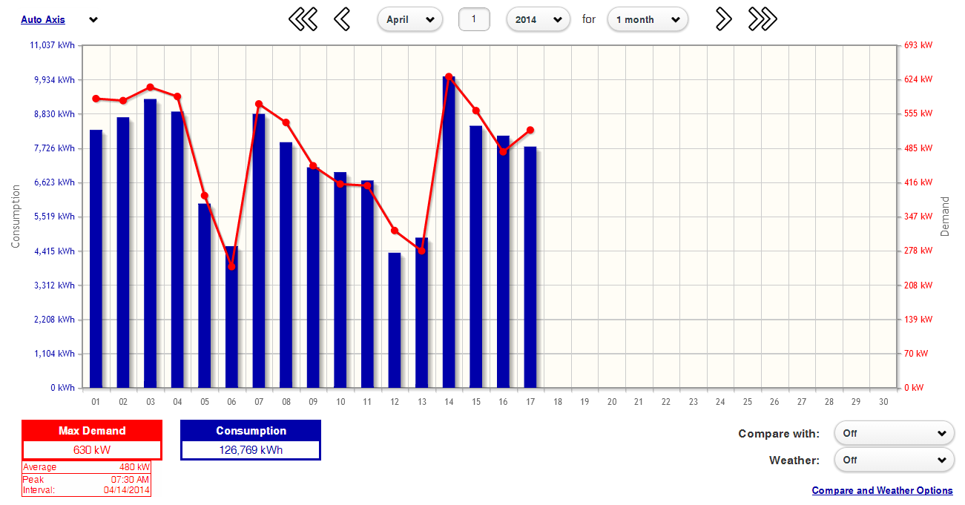
Reporting Graphs – Daily Data

Slide 10
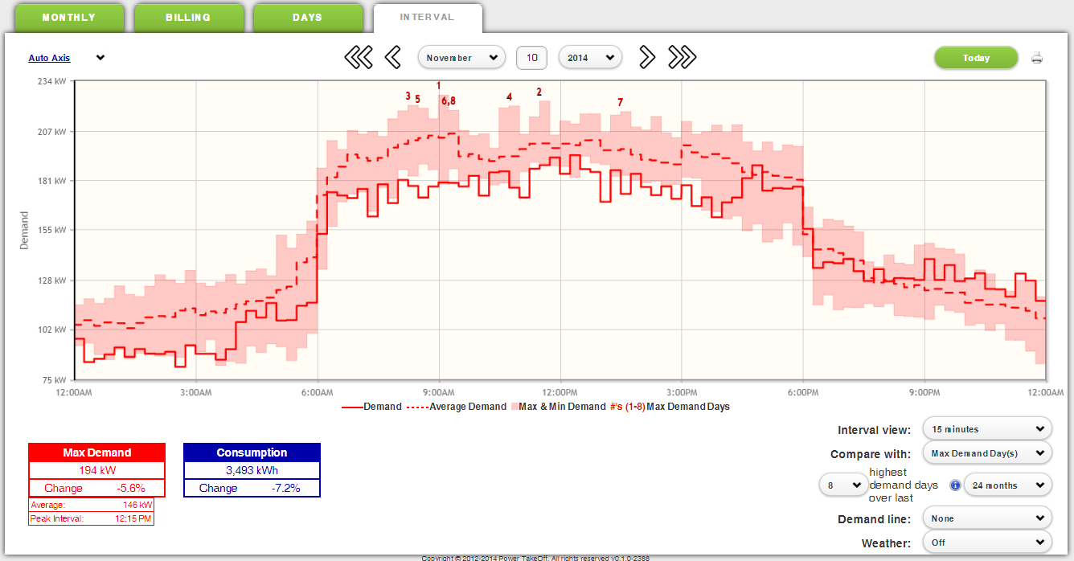
Easily Identify Peak Demand Times

Slide 11
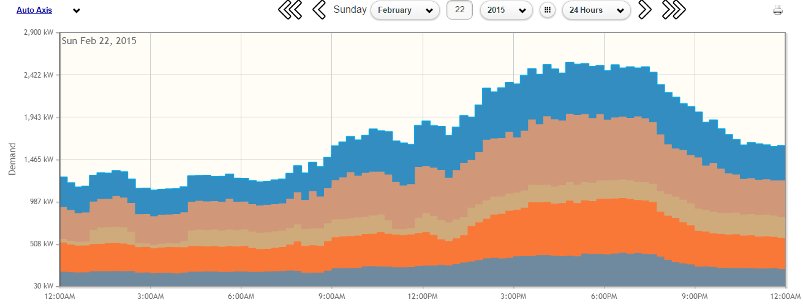
Analyze Sub-Meter Impact as a Whole
In this screen we are showing 5 sub-meter channels stacked on top of one another to show their individual usage impact and as a collective total. Users can easily control which data is shown and what color it is displayed as on the graph.

Slide 12
Interactive Kiosk
CONFIDENTIAL

Slide 13
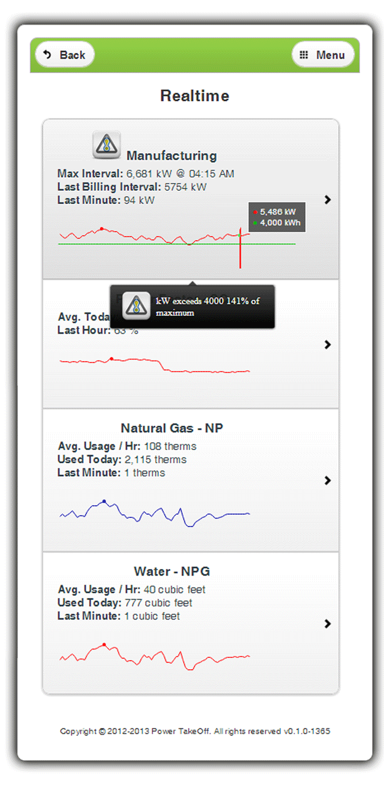
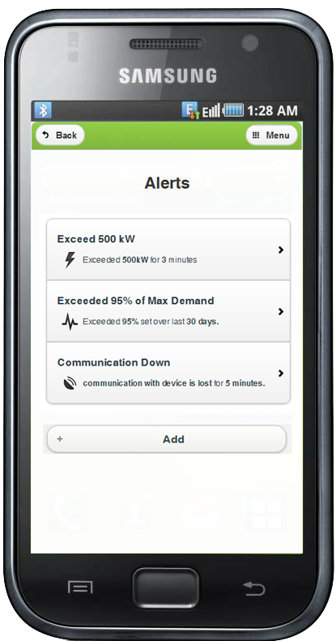
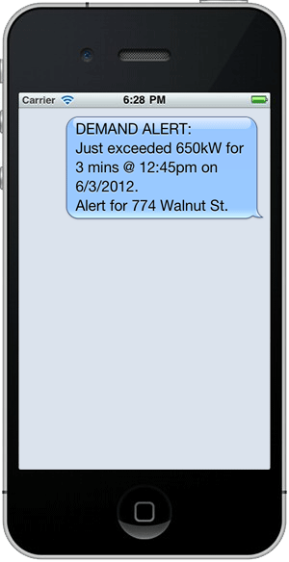
Real-time, Multi-user Alerts & Goals
CONFIDENTIAL
Voice call to your phone
Email to your computer or cell
Text message to your mobile

Slide 14
Making it Happen – Implementing a Best Practices Approach
Build an effective team
Establish a monthly reporting process
Implement equipment retrofit and operational improvement projects
Leverage utility program incentives
Validate the results
Expand your monitoring/metering deployment
Lather, rinse, repeat

Slide 15
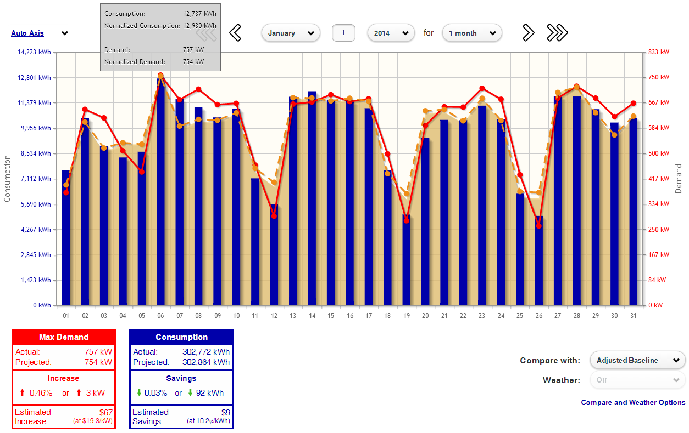
Validate the Results

Slide 16
Looking to the Future – New and Upcoming Diagnostic Tools
Monetization
kW and kWh utility rates
Usage and demand split
Alternate demand cost opportunities
Conditional Reporting
Monthly or Weekly
Demand/usage threshold or percentage change
Energy, Carbon, Cost

Slide 17
Looking to the Future – New and Upcoming Diagnostic Tools
Portfolio View
Comparison/ranking of multiple facilities
kW/kWh
Utility Cost
Energy Utilization Index (EUI)
Energy Star Portfolio Manager Score

Slide 18
Contact Information
David Gibson, PE
Vice President of Engineering
David.Gibson@powertakeoff.com
303-475-7930
www.powertakeoff.com

Slide 19
Questions?

